Slide 1
Day 2 - Vectors, Matrices, and Images
Some of the figures were generated by Copilot or ChatGPT

Slide 2
HW Review
Solutions to Day 1 HW

Slide 3
Recap of Day 1
The print() function is super useful.
Basic math and basic logic is easy to do in python
There are different data types and data is stored in variables
Lists are ordered lists of items
You can access these items via index
Loops loop through lists and run the same bit of code repeatedly
Conditionals only run code if a condition is met
Functions make doing complex code many times easier
Classes are a collection of variables and functions
Packages are a collection of classes and functions

Slide 4
What is a Vector?

Slide 5
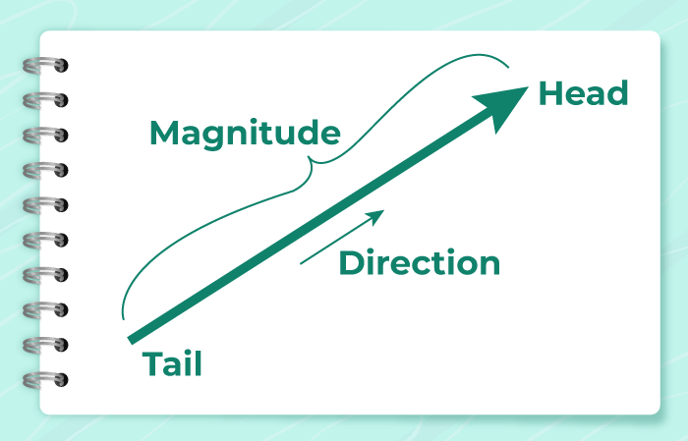
One way to think about vectors are as arrows
From GeeksForGeeks

Slide 6
In CS, vectors are often viewed of as lists of numbers that describe something
226
163
15
Color as a Vector:
[Red, Green, Blue]

Slide 7
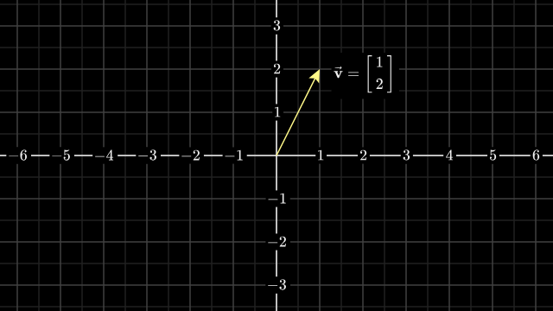
Going in between these two views
From 3Blue1Brown

Slide 8
Dimensionality
Every vector has a dimensionality which describes how many dimensions are needed to describe it.
For arrows, the dimensionality is how many axes it uses - 2D vectors need an x-axis and a y-axis, 3D would need a z axis
For lists, the dimensionality is equal to how many values there are. 2 values - 2D, 3 values - 3D, 100 values - 100D
Although the visual of dimensionality breaks down after 3D, higher dimension vectors very much exist.

Slide 9
Adding Vectors: Head to Tail and Adding Numbers
3
3
2
0
5
3
When adding arrows, your connect the head of one to the tail of the other and then draw the new arrow
When adding lists of numbers, just line them up and add numbers on the same line.

Slide 10
Scaling Vectors: Doubling length and multiplying numbers
1
-1
When you scale an arrow, you change its length by the scaling factor, while holding the angle the same
When you scale a list of numbers, you multiply each component by the scaling factor.
Scaled by 2 is
Scaled by 2 is
2
-2

Slide 11
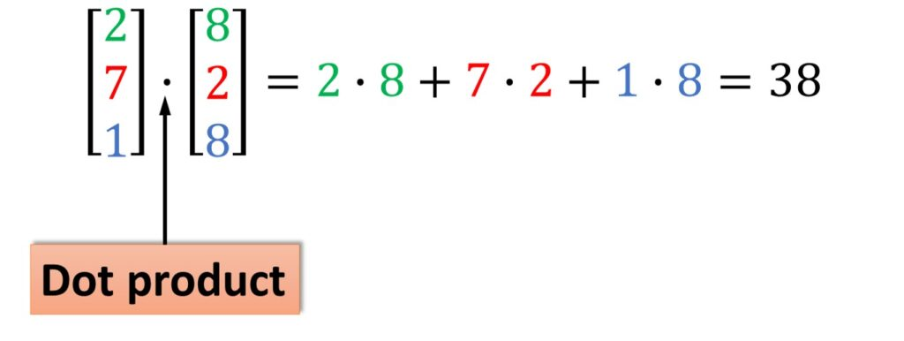
Dot Product: Pair up, then multiply and add
If dot product > 0 - arrows are in the same direction
If dot product < 0 - arrows are in opposite directions
If dot product == 0 - arrows are perpendicular
From Datahacker’s Linear Algebra Course

Slide 12
What is a Matrix?

Slide 13
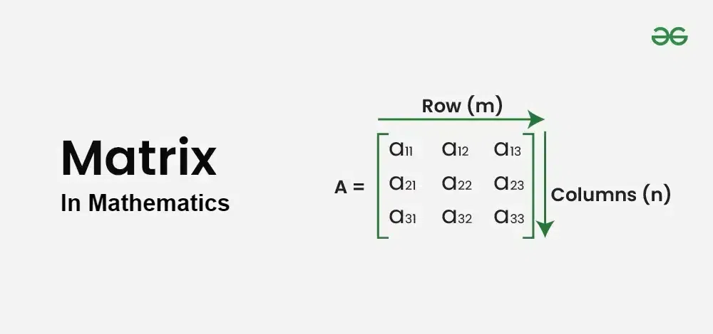
Matrices

Slide 14
Adding and Scaling Matrices works the exact same way as adding and scaling vectors (as lists of numbers)

Slide 15
Matrix-Vector Multiplication is a bit more confusing

Slide 16
Doing all of this with Code
Notebook

Slide 17
Color

Slide 18
Grayscale colors are just one value
0
1
Grayscale is one value between 0 and 1

Slide 19
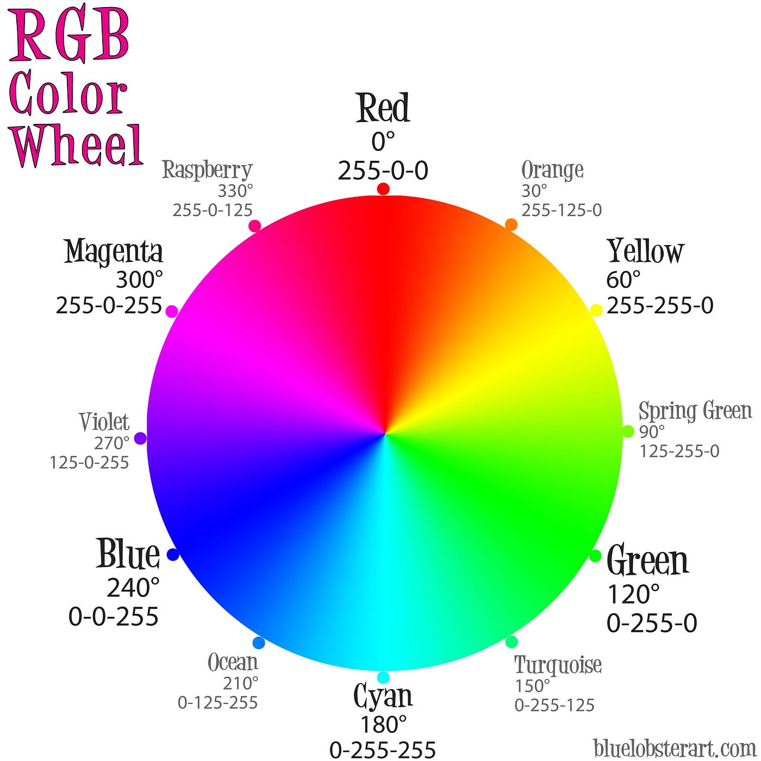
To represent other colors, we use vectors
Red
❰ Green ❱
Blue

Slide 20
Images

Slide 21

Images are stored as a matrix of vectors
color11 color12 color13 …
color21 color22 color23 …
color31 color32 color33 …
. . . . . . . . . . . . . . . . . . . . . . . . . . . . . . . . . . . . . . . . . . . . .

Slide 22
Mini Projects

Slide 23
Intro to Convolutions

Slide 24
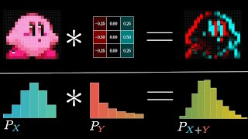
Convolutions are a new type of operation
From 3Blue1Brown

Slide 25
Homework

